Slide 1

How Consensus Is Reached
Exploring Proof-of-Work, Proof-of-Stake, and Beyond.

Slide 2

What is Consensus in Blockchain?
Definition
Why It's Needed
Agreement among nodes on the current state of the blockchain.
Prevents fraud, ensures one version of truth.
Real-Life Analogy
A class vote for a class representative; the majority decides.

Slide 3
Overview of Consensus Mechanisms
Proof of Work (PoW)
Proof of Stake (PoS)
Delegated Proof of Stake (DPoS)
Energy-intensive mining to validate transactions.
Validators chosen by coin ownership for efficiency.
Stakeholders vote for a limited number of delegates.
Proof of Authority (PoA)
Practical Byzantine Fault Tolerance (PBFT)
Trusted entities validate transactions in private networks.
Agreement achieved despite malicious nodes in permissioned chains.

Slide 4




Proof of Work (PoW) – Concept
Mining Puzzles
Miners solve complex cryptographic puzzles.
Nonce Guessing
They guess a 'nonce' to achieve a target hash.
High Energy
This process consumes significant energy and computation.

Slide 5
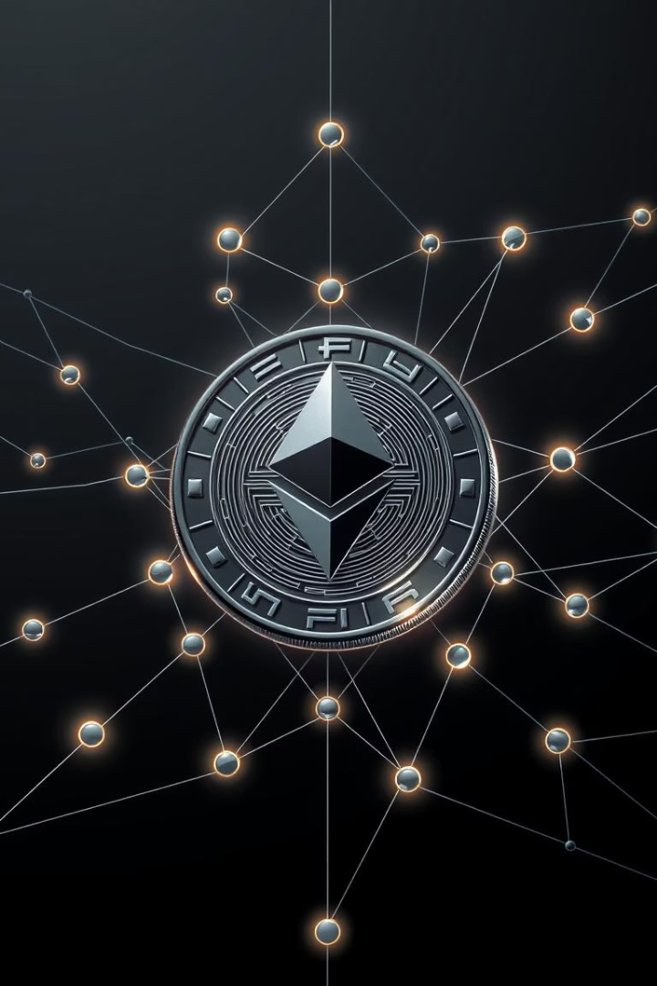



Proof of Stake (PoS) – Concept
Coin Ownership
Energy Efficient
Higher Chance
Validators are chosen based on their coin ownership, or "stake."
It requires less computation and is more energy efficient.
A larger stake increases the chance to validate blocks.

Slide 6
Other Consensus Mechanisms
DPoS: Delegated Proof of Stake
PoA: Proof of Authority
PBFT: Practical Byzantine Fault Tolerance
Transactions are validated by a set of pre-approved, trusted validators. Often used in private or consortium blockchain networks.
Stakeholders vote to elect a limited number of validators, similar to electing a parliament.
Enables agreement within a network even if some nodes act maliciously. Commonly used in permissioned chains.

Slide 7








Delegated Proof of Stake (DPoS) – Concept
Vote for Delegates
PoS Variation
Coin holders vote for delegates, also called witnesses or validators.
DPoS is a variation of Proof of Stake.
Voting Power
Limited Delegates
Voting power is proportional to the amount of stake held.
Only a limited number of delegates validate and create blocks.

Slide 8




DPoS – How It Works
Token Holder Votes
Token holders cast votes using their staked coins.
Top Delegates
The top delegates gain rights to produce blocks.
Rotating Turns
Delegates take turns creating new blocks.
Voted Out
Poor-performing delegates can be voted out by the community.

Slide 9

DPoS – Technical Characteristics
Fast Block Confirmation
Blocks are confirmed quickly due to fewer validators.
Low Energy Usage
No mining involved, leading to minimal energy consumption.
Governance Layer
Voting mechanism enables direct community governance.
Active Participation
Requires ongoing engagement from stakeholders.

